Slide 1
CS6501/ECE6501 IoT Sensors and Systems
November 29, 2017
Brad Campbell – bradjc@virginia.edu
http://www.cs.virginia.edu/~bjc8c/class/cs6501-f17/

Slide 2
Main Course Topics
IoT Stack
Applications
Sensors, Hardware, and Energy
Networking
Programming and Security
Data Analysis
Data Storage
Ensemble Programming
User Interface
Applications
Connectivity
Operating Systems
Hardware Platforms
Hardware Primitives

Slide 3
Applications
Outdoor (Remote)
Great Duck Island
Bat Tracking in Australia
Outdoor (Urban)
Array of Things
Air Quality Monitoring
Indoor
Sentinel
CapNet
Democratic Monitoring
SeaGlass
Personal Heath
LIBS
Opo
Industrial
Pipeline Leak Detection
Alps localization
Safety
Gunshot Detection
LOOKUP for Pedestrians

Slide 4
What leads to good application-driven research?
Actually target a real problem
Comprehensive, paying attention to the details
Justify decisions
Consider the people!
Performance has to meet the bar
Defining application constraints

Slide 5
Low-level: Sensors, Hardware, and Energy
Platforms
TelosB
M3
Firestorm
Energy-harvesting
HydroWatch
Monjolo
Tragedy of the Coulombs
DoubleDip
Hardware Generation
EDG
Sensing
Soli
Synthetic Sensors

Slide 6
Is this category holding back the IoT?

Slide 7
Networking
Low Power Wireless
LPL
Low power Wireless Bus
IPv6 Networking
IP is Dead, Long Live IP
Backscatter
BLE->WiFi
Gateways
IoT Gateway Problem
Whitespaces
SNOW

Slide 8
Will we see consensus in networking protocols?

Slide 9
Programming and Security
Operating Systems
SOS
DINO
Blockchain
Overview
Sharing with smart contracts
IoT Frameworks
HomeOS
Ravel
IoT Security
SmartAuth
Electromyography
Misusing Sensors
Gyrophone
PitchIn

Slide 10
What’s the threat model for the IoT?

Slide 11
Our “Best Paper”
Array of Things: A Scientific Research Instrument in the Public Way
Charles E. Catlett, Peter H. Beckman, Rajesh Sankaran, Kate Kusiak Galvin
“A good insight with respect to how edge computing can offer a way to support image analysis without incurring the costs of communications or privacy risks”
“Easier to answer some ethical questions that may arise”
“Strength was the actual public engagement of the project”
“Every design decision…is justified”
“A strength was…addressing the needs of multiple scientific disciplines”

Slide 12
Other leaders
Presentation: Monjolo: An Energy-Harvesting Energy Meter Architecture
Interest: SeaGlass: Enabling City-Wide IMSI-Catcher Detection
Impact: (tie) Array of Things, Telos
Confidence: Soli: Ubiquitous Gesture Sensing with Millimeter Wave Radar

Slide 13
What are the characteristics of strong papers?
More figures in the design section!
Informative captions
Strong introduction
Helping non-experts understand
Explaining background
State and justify assumptions

Slide 14
What should you not do?
“This paper fails to answer the question: Why conduct this research?”
“it may not be enough for real-world use cases”
“no ground truth readings”
“does not discuss possible applications of the technology”

Slide 15
Future directions…

Slide 16
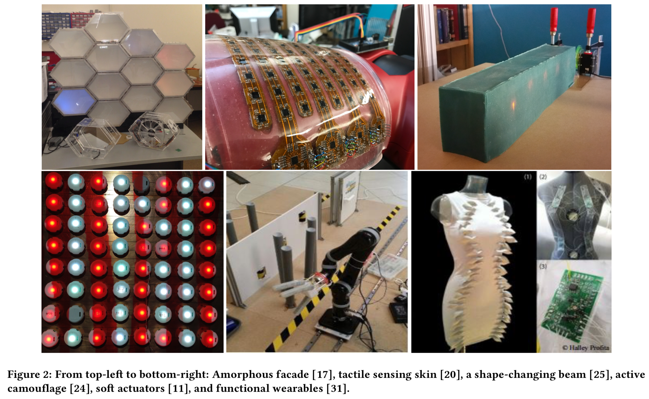
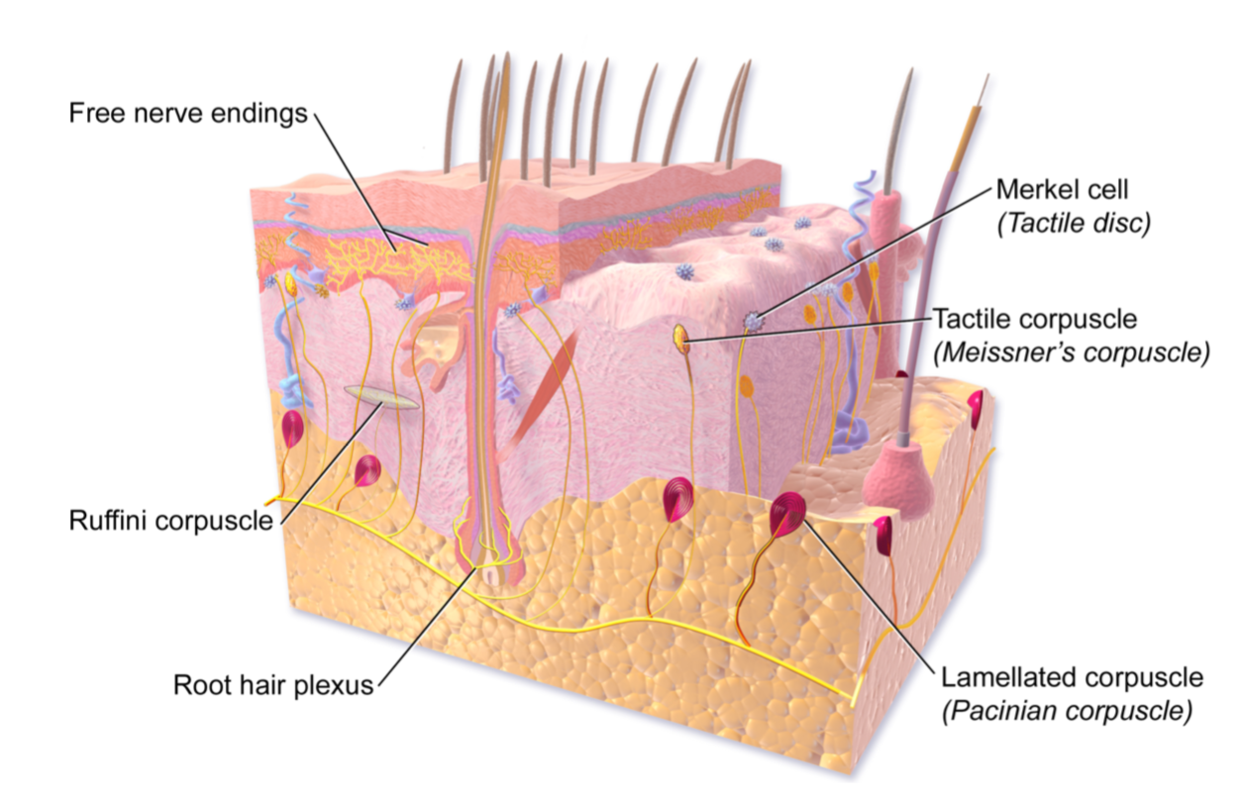
Wireless Robotic Materials
Bandages that react to the wound?
“Aircraft that adapt their aerodynamic profile to varying flight modes, saving energy and reducing noise, while exhibiting the agility of a bat and the efficiency of a goose”?

Slide 17
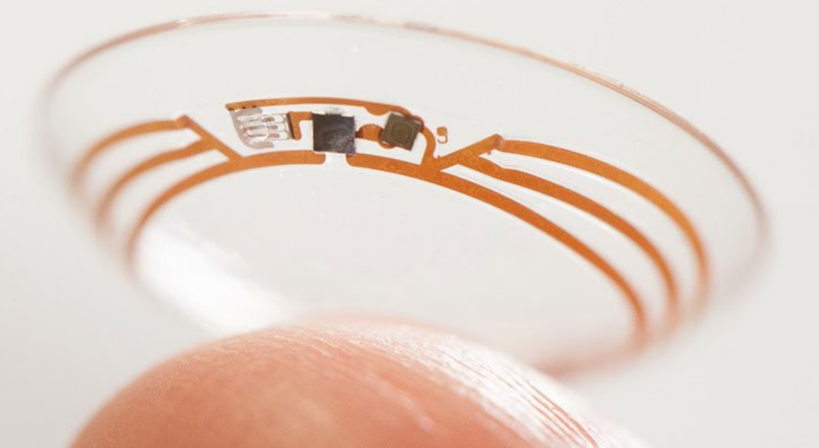
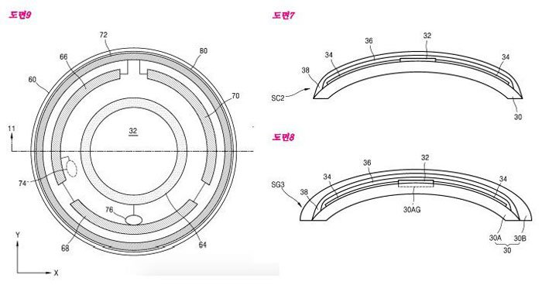
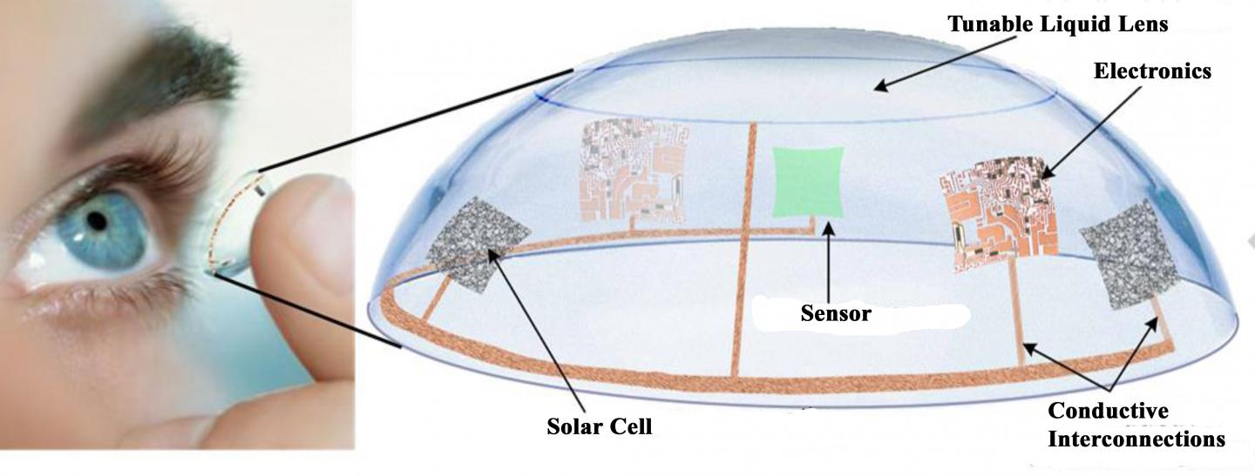
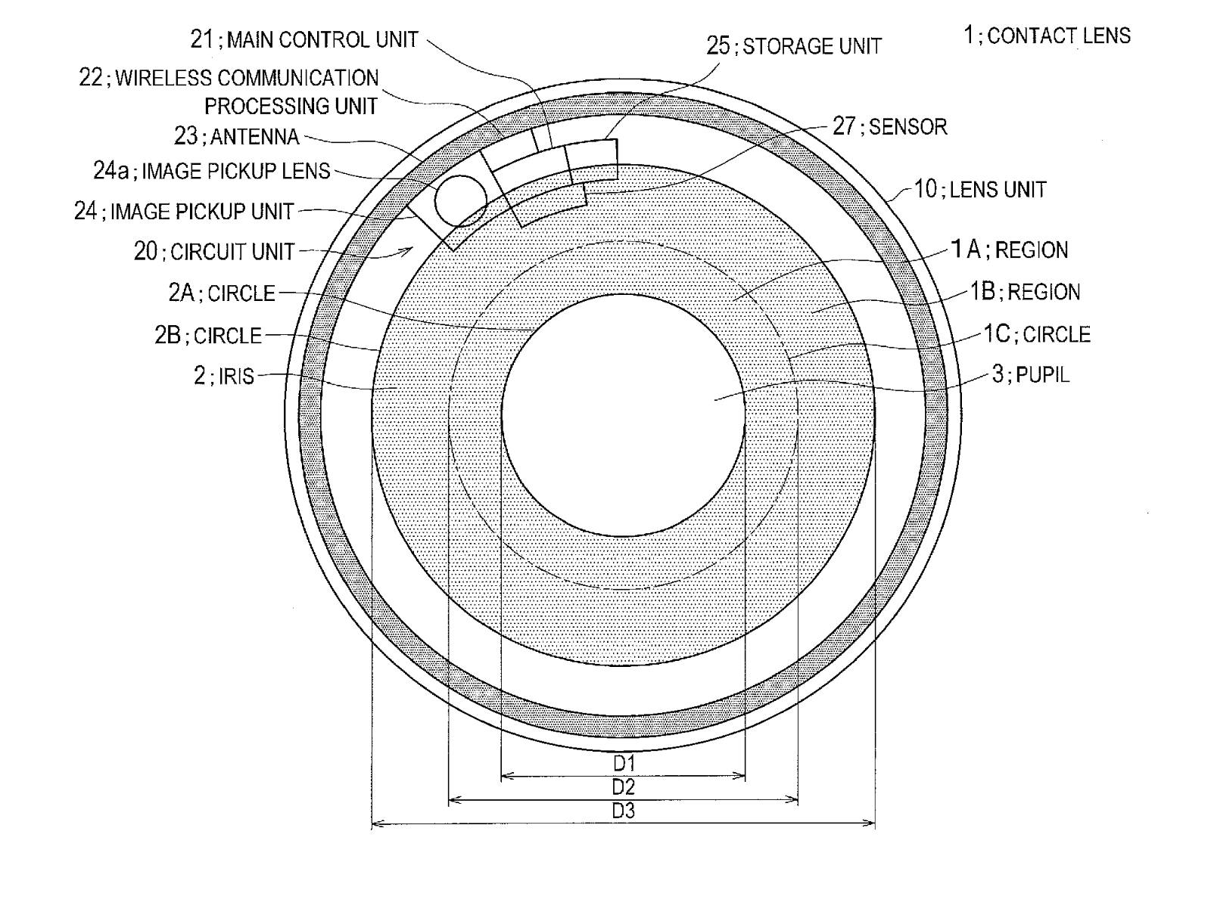
Smart contact lenses
Patent diagrams for Samsung's smart contact lenses. Credit: Samsung/Korea Intellectual Property Right Service (KIPRIS)

Slide 18
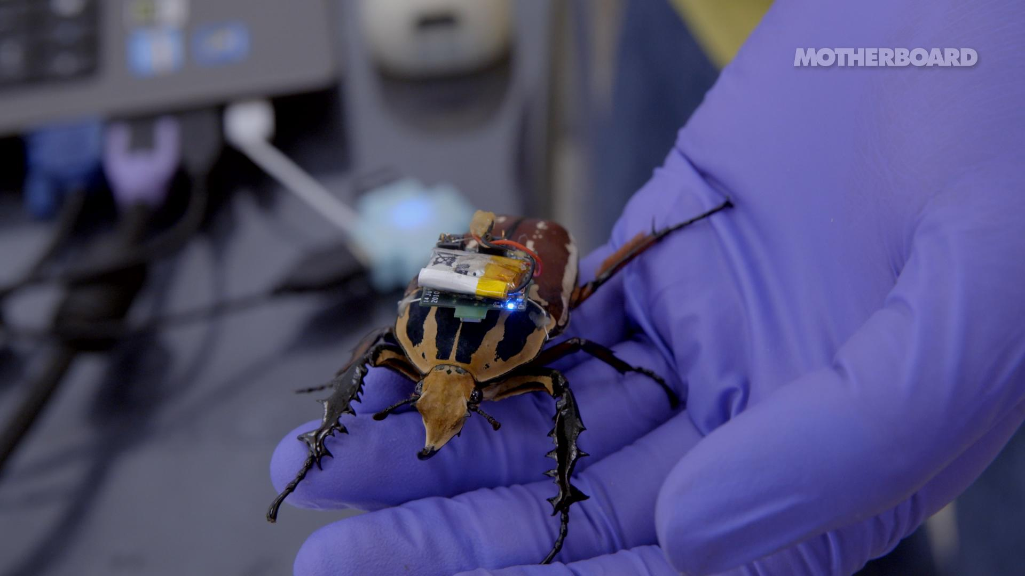
Controlling bugs!

Slide 19
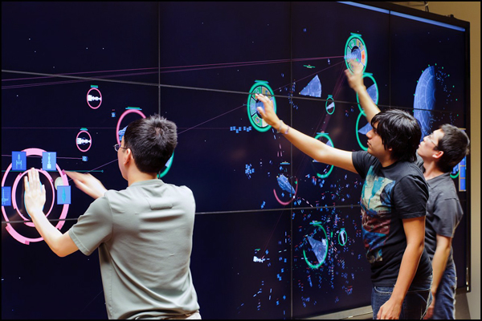
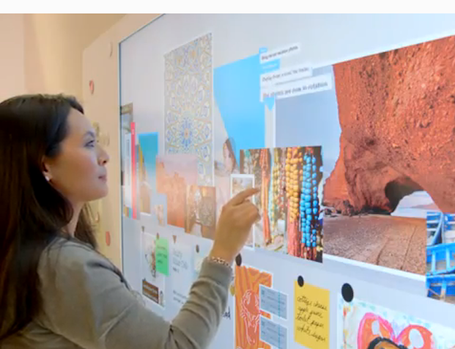
Personal ambient computing
“Create calm”?

Slide 20
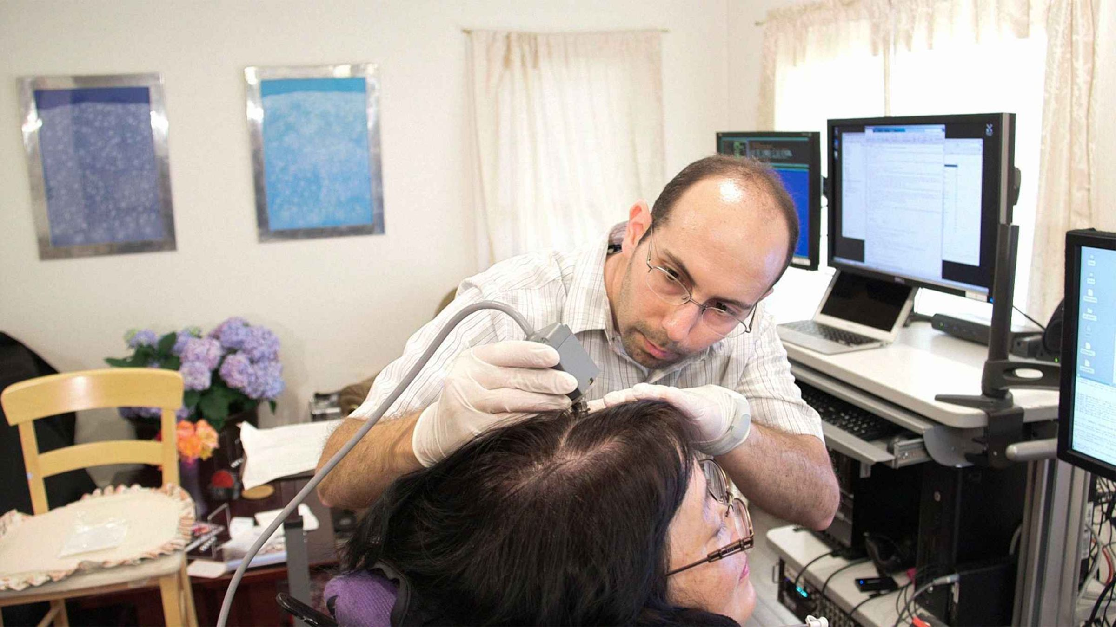
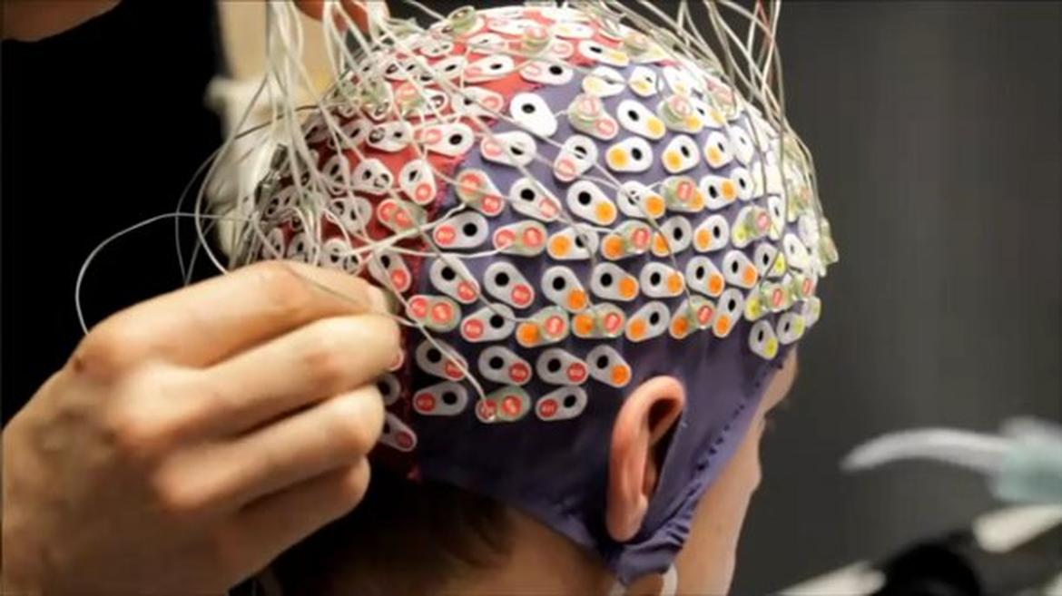
Brain-computer interface
Will we have smartphones in 5 years? 20?

